Slide 1
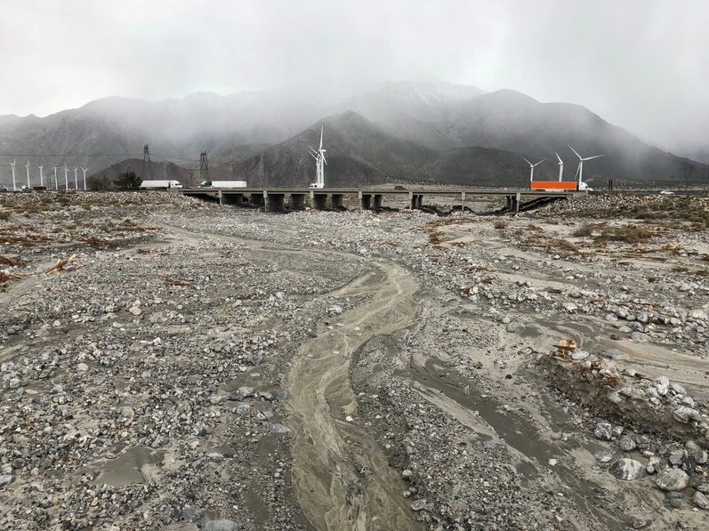
Taking on River Woes:
The Whitewater River Bridge’s Battle with Bed Degradation in California’s High Desert
NHEC 2024
Biloxi, Mississippi
Date: August 28, 2024
Presented by:
Oscar Suaznabar
2019
Notes:
Good morning/afternoon everyone.
Today, I am excited to present to you our project on addressing scour and channel bed degradation at the Whitewater River Bridge located in the high desert region of Southern California.
This bridge, which plays a critical role in the local transportation network, has been facing significant challenges due to extensive scour and ongoing channel bed degradation, exacerbated by recent extreme weather events.
Our project aims to thoroughly investigate these issues using innovative surveying techniques,
and to develop effective mitigation strategies to enhance the bridge's resilience and ensure its long-term stability.

Slide 2
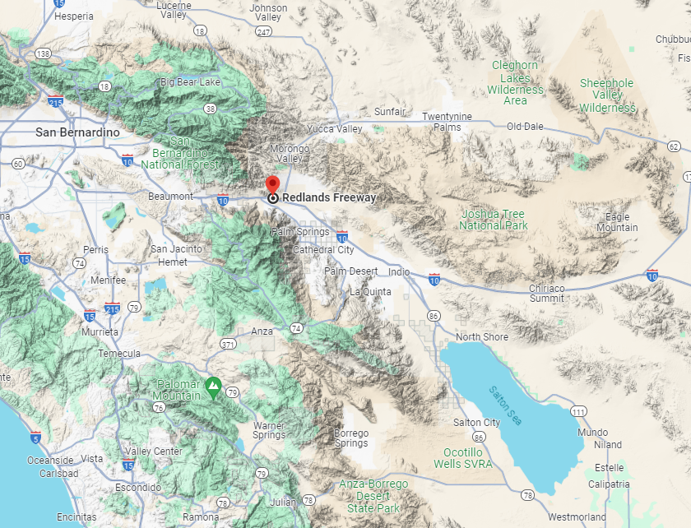
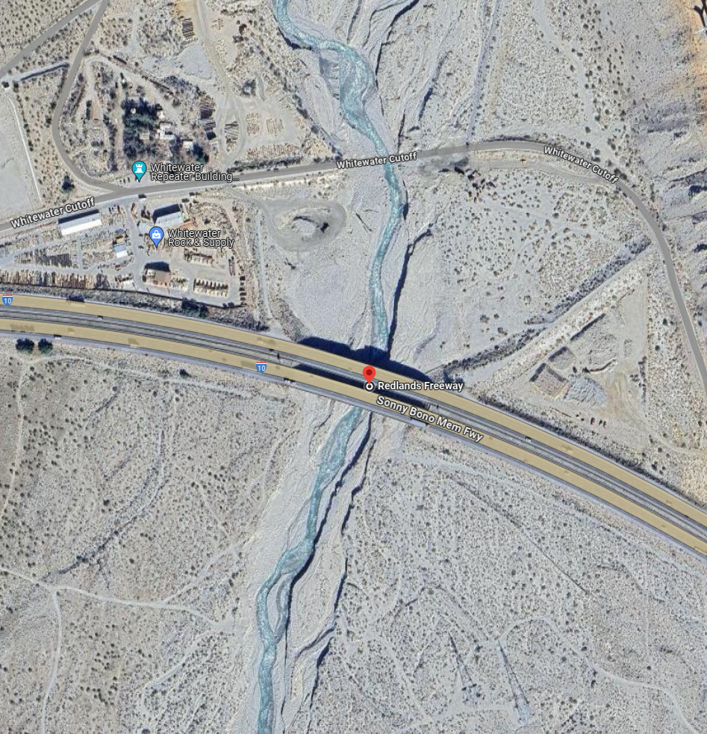
1. OVERVIEW
Name of Structures: Whitewater River
Location: District 8 – Riverside County
Facility Carried: INTERSTATE 10
Upstream Bridge: Br.No. 56-0004L (I-10 WB)
Structure Length: 507.5 feet (8 Spans)
Lanes: 4
ADT: 39500 (Truck ADT 22%)
Downstream Bridge: Br.No. 56-0004R (I-10 EB)
Structure Length: 502.3 feet (8 Spans)
Lanes: 4
ADT: 39500 (Truck ADT 22%)

Slide 3
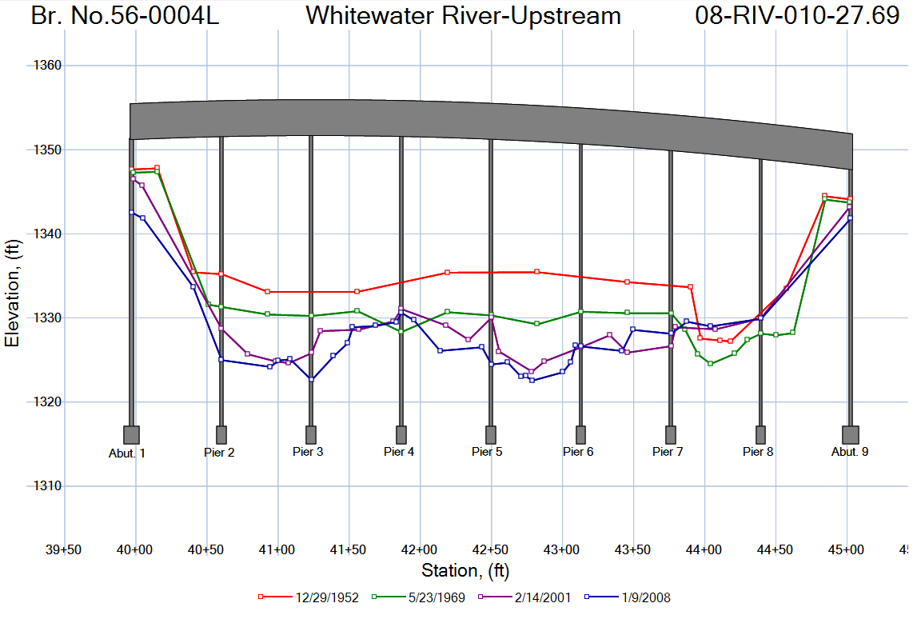
2. BRIEF HISTORY
Original Structure built in 1952, 8 Span continuous RC “T-beam” girder with RC deck on RC pier walls and diaphragm abutments. All on spread footings.
1967, Left and Right Widening.
2008, designated SCOUR CRITICAL, attributed to streambed degradation in the vicinity of the structure and the potential for undermining of the spread footings.
2008, Placement of rock slope protection (RSP) around Piers 6 and 7.
2013, RSP was installed around the two abutments and the remaining piers.

Slide 4
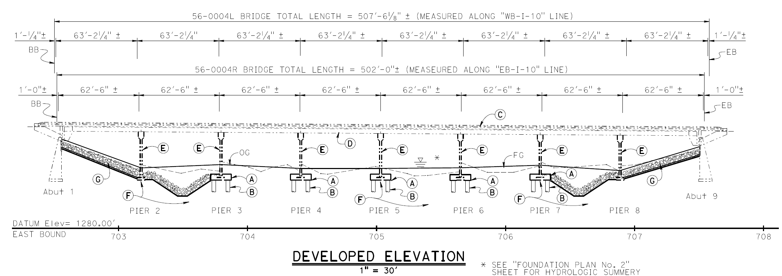
2. BRIEF HISTORY CONT’D
2021 – Scour
Mitigation Retrofit
As-Built Plans
Incorporating rock slope protection (RSP) on both abutment slopes that extended to the adjacent Piers 3 and 7, respectively.
Pile caps were retrofitted with the addition of 36-inch diameter Cast-In-Drilled-Hole (CIDH) piles at the foundation of Piers 3, 4, 5, 6, and 7.

Slide 5
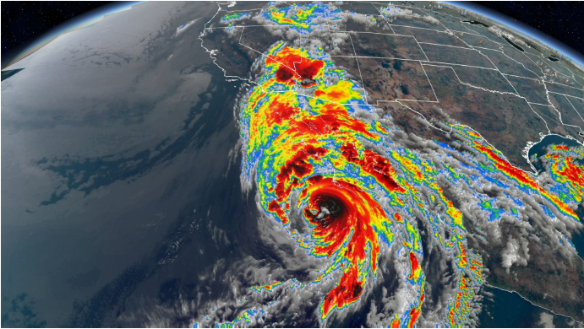
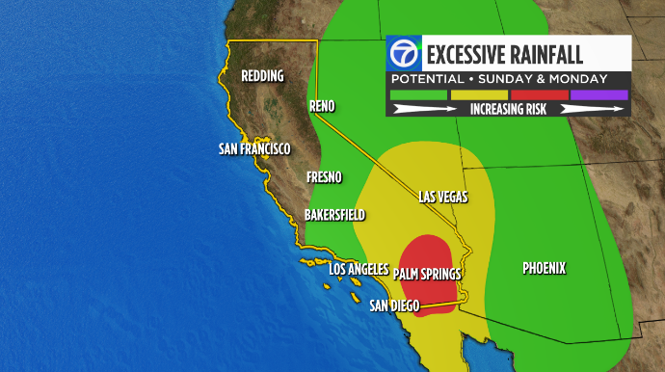
3. FIELD INVESTIGATION (2023-2024)
Historic rainfall in August 2023 – Tropical Storm Hilary
Rainfall totals from Hilary reached 11.7 inches in approx. 24 hours in the San Bernardino Mountains.
San Bernardino Mountains drain into Coachella Valley through Whitewater River.
Source: hpnonline.org
Link to Video:
https://www.reddit.com/r/Damnthatsinteresting/comments/15wv7kg/massive_debris_flow_in_palm_springs_ca_from/?utm_source=share&utm_medium=mweb3x&utm_name=post_embed&utm_term=1&utm_content=1

Slide 6
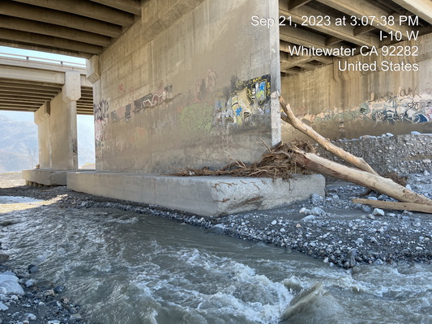
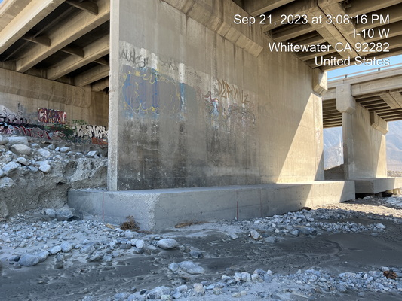
3. FIELD INVESTIGATION
SEPTEMBER - OCTOBER 2023
Pier 5
Pier 6
From Upstream, looking downstream at Pier 5 of left bridge.
From Upstream, looking downstream at Pier 6 of left bridge.

Slide 7
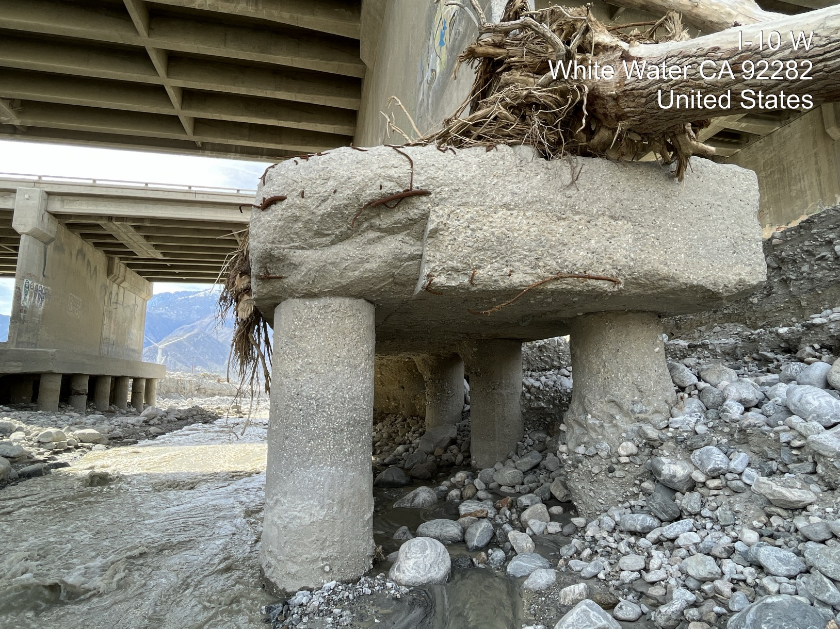
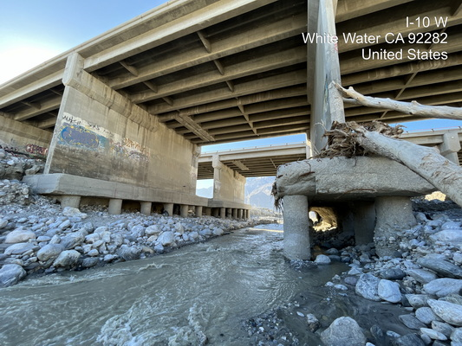
3. FIELD INVESTIGATION
FEBRUARY 2024
Pier 5
Pier 6
Pier 6
Pier 5
Pier 5
From Upstream, looking downstream at Pier 5 of left bridge.
From Upstream, looking downstream at Piers 5 and 6 of left bridge.

Slide 8
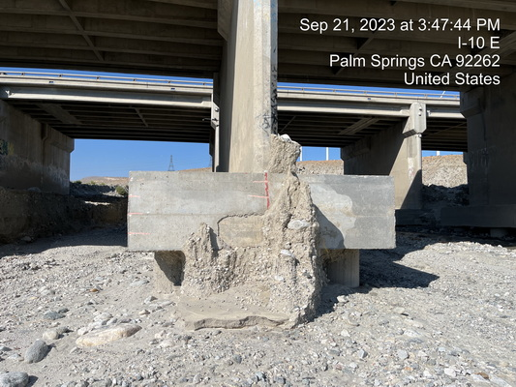
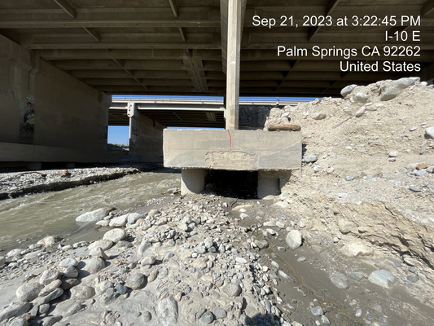
3. FIELD INVESTIGATION
SEPTEMBER - OCTOBER 2023
Pier 6
Pier 5
From Downstream, looking upstream at Pier 5 of right bridge.
From Downstream, looking upstream at Pier 6 of right bridge.

Slide 9
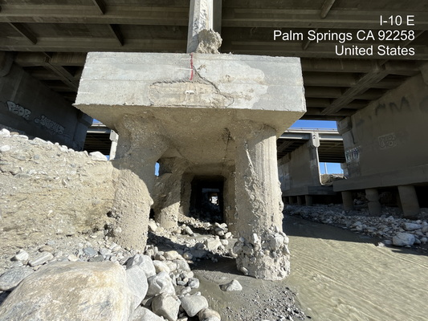
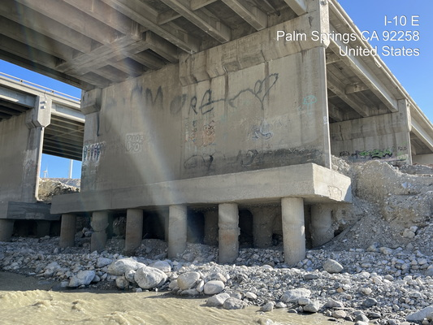
3. FIELD INVESTIGATION
FEBRUARY 2024
Pier 5
Pier 6
From Downstream, looking upstream at Pier 5 of right bridge.
Standing under Span 5, looking at
Pier 6 of right bridge.

Slide 10
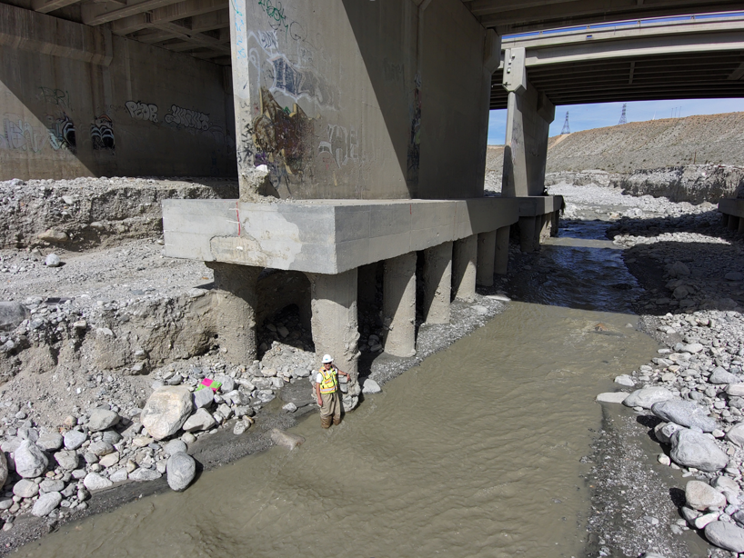
3. FIELD INVESTIGATION
FEBRUARY 2024
Pier 5
From Downstream, looking upstream at Pier 5 of right bridge.

Slide 11
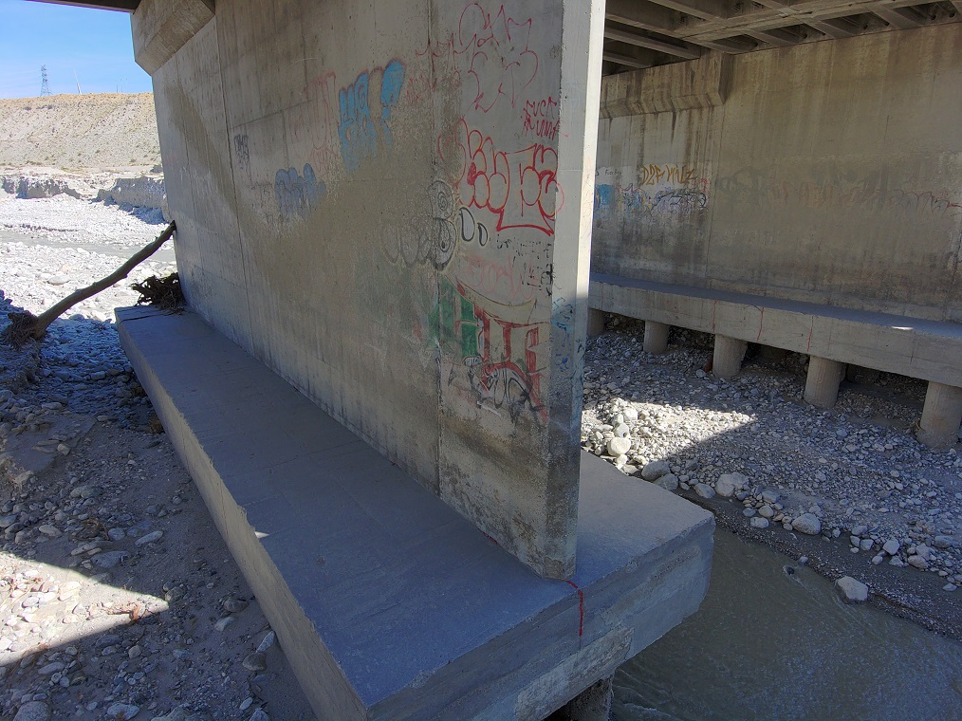
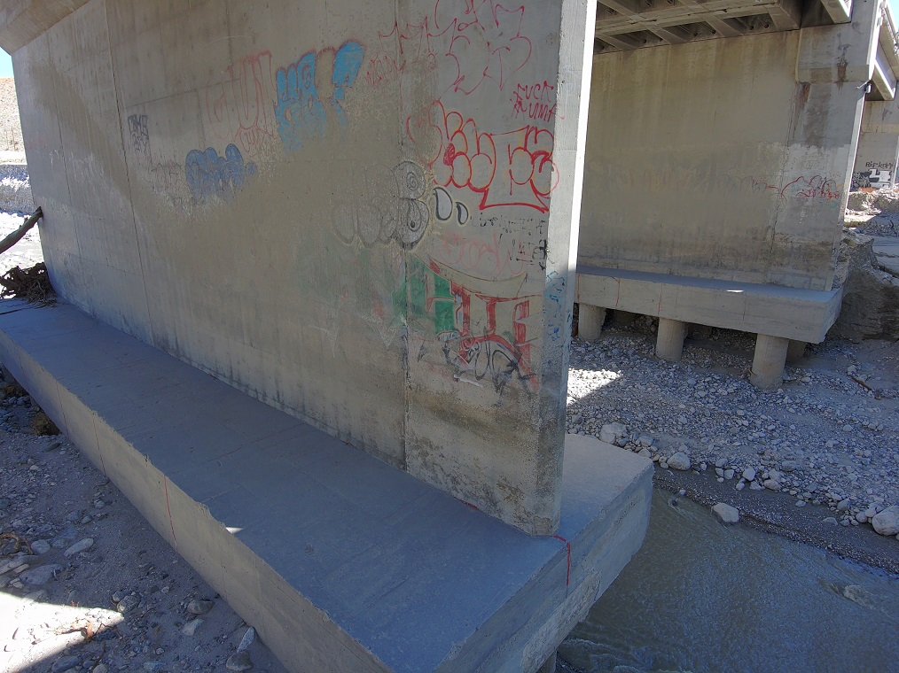
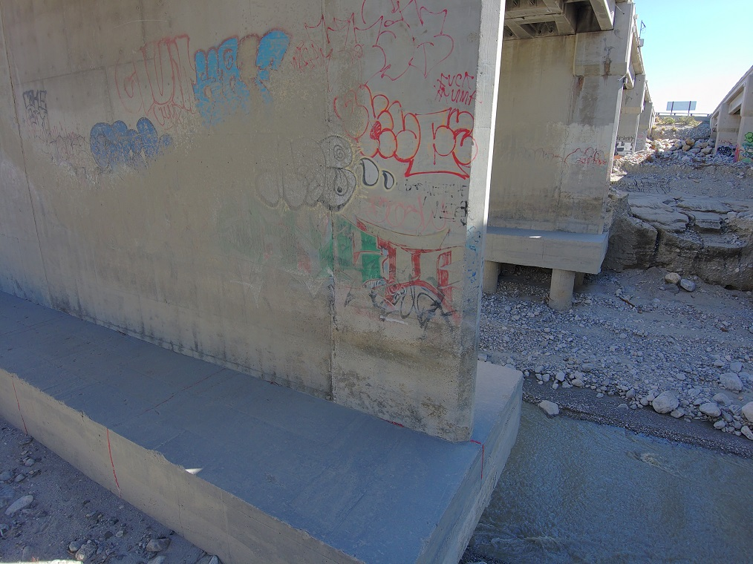
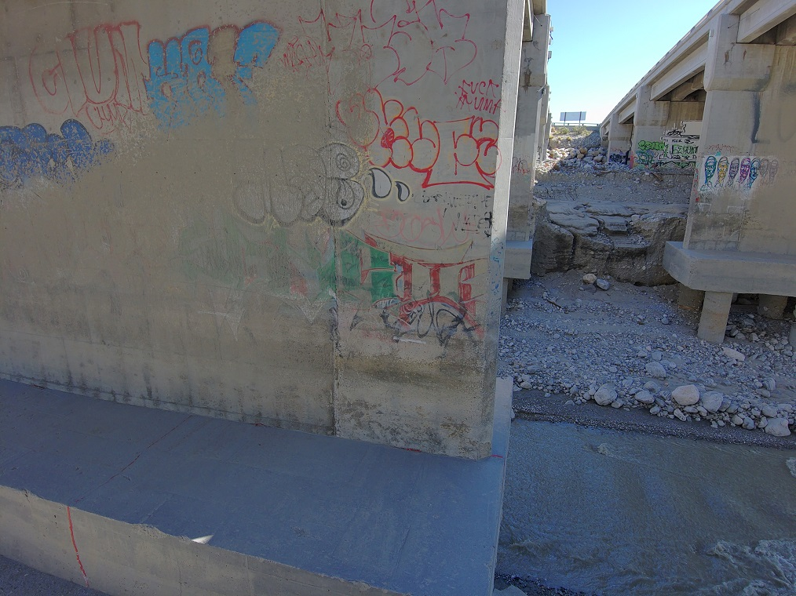
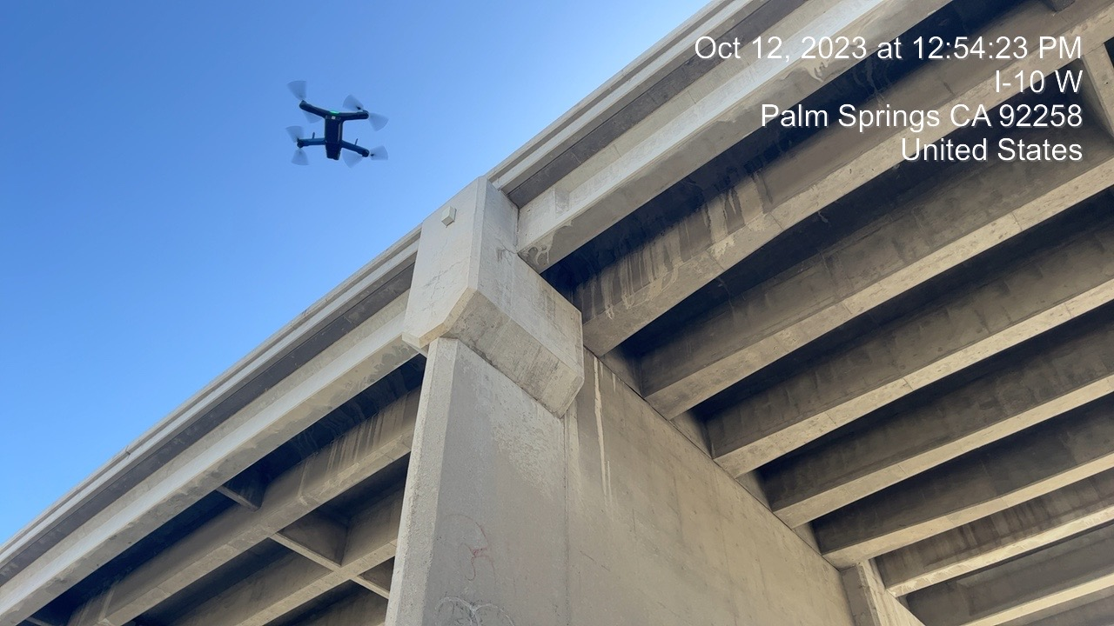
3. FIELD INVESTIGATION (2023-2024)
METHODOLOGY AND TOOLS USED
Drone plans a path based on AI-driven workflow
Drone autonomously captures all surfaces of a scene.
Skydio 3D Scan Mapping:
Drone plans a path based on AI-driven workflow.

Slide 12
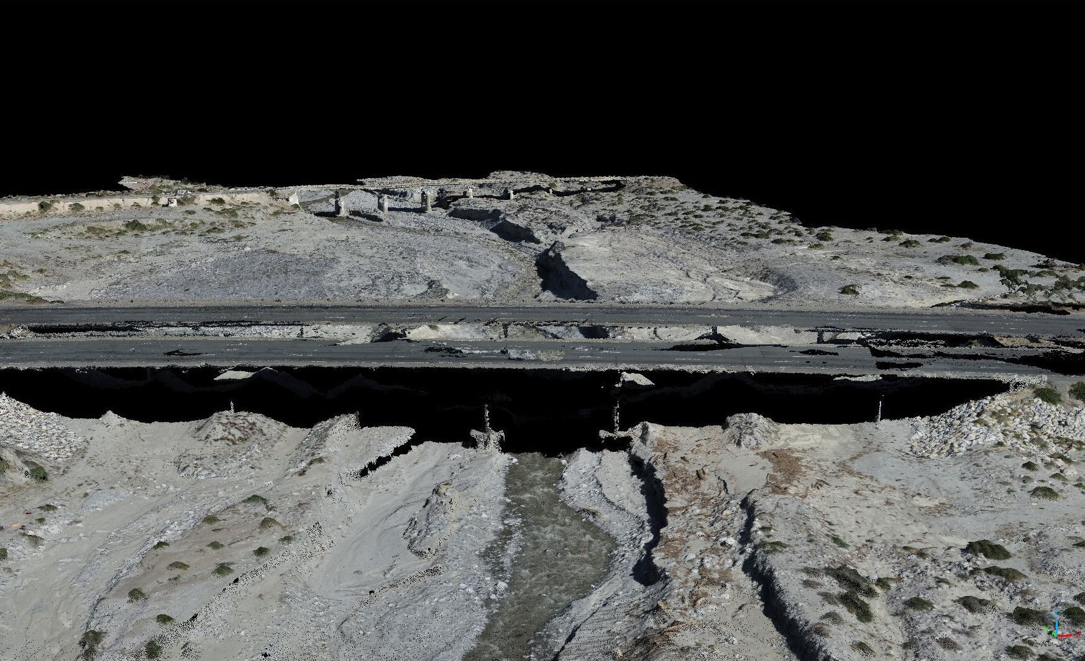
3. FIELD INVESTIGATION (2023-2024)
METHODOLOGY AND TOOLS USED
Drone plans a path based on AI-driven workflow
Drone autonomously captures all surfaces of a scene.
Field Investigation October 2023
Conventional UAS-based Photogrammetry
+
Skydio 3D Scan Mapping:

Slide 13
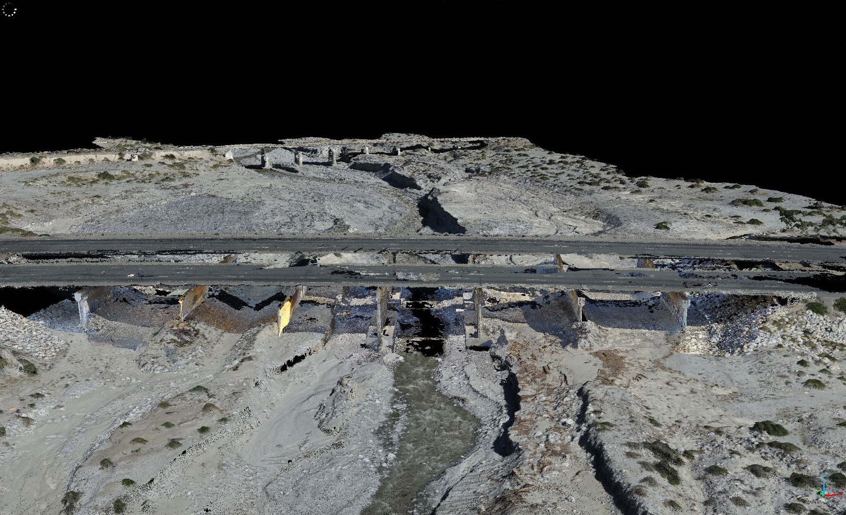
3. FIELD INVESTIGATION (2023-2024)
METHODOLOGY AND TOOLS USED
Field Investigation October 2023
Conventional UAS-based Photogrammetry
+
Skydio 3D Scan Mapping

Slide 14
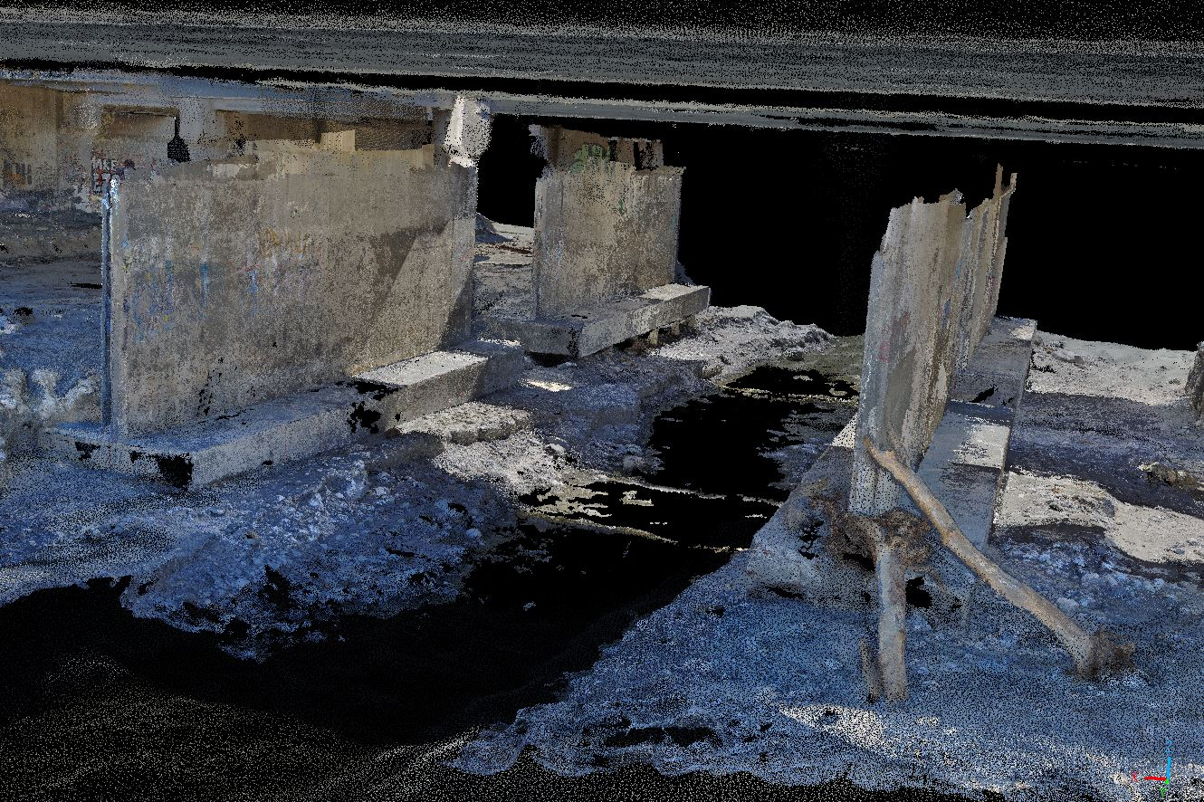
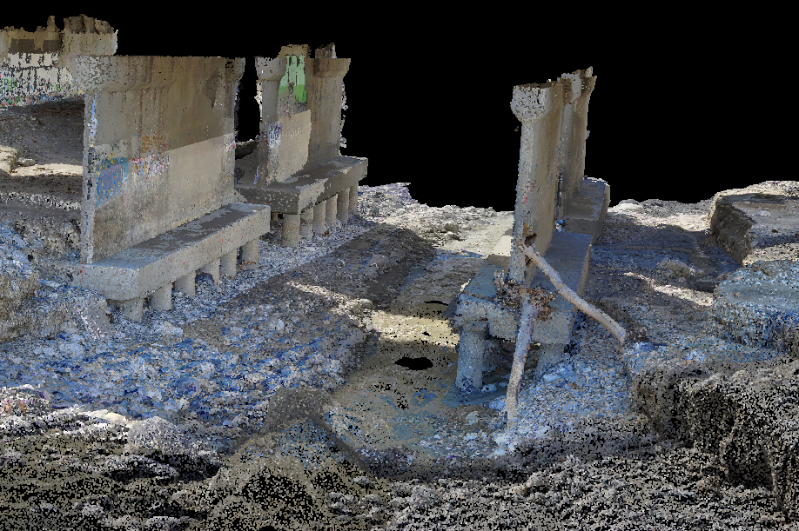
3. FIELD INVESTIGATION
OCTOBER 2023 VS. FEBRUARY 2024
Pier 6
Pier 6
Pier 5
Pier 5
3D Point Cloud – October 2023 (Skydio 3D Scan)
3D Point Cloud – February 2024
(Skydio 3D Scan)

Slide 15
3. FIELD INVESTIGATION
OCTOBER 2023 VS. FEBRUARY 2024 CONT’D
Pier 5
Pier 6
Average Bed Elevation
October 2023
3D Point Cloud – October 2023

Slide 16
3. FIELD INVESTIGATION
OCTOBER 2023 VS. FEBRUARY 2024 CONT’D
Pier 5
Pier 6
Average Bed Elevation
October 2023
Average Bed Elevation
February 2024
3D Point Cloud – February 2024

Slide 17
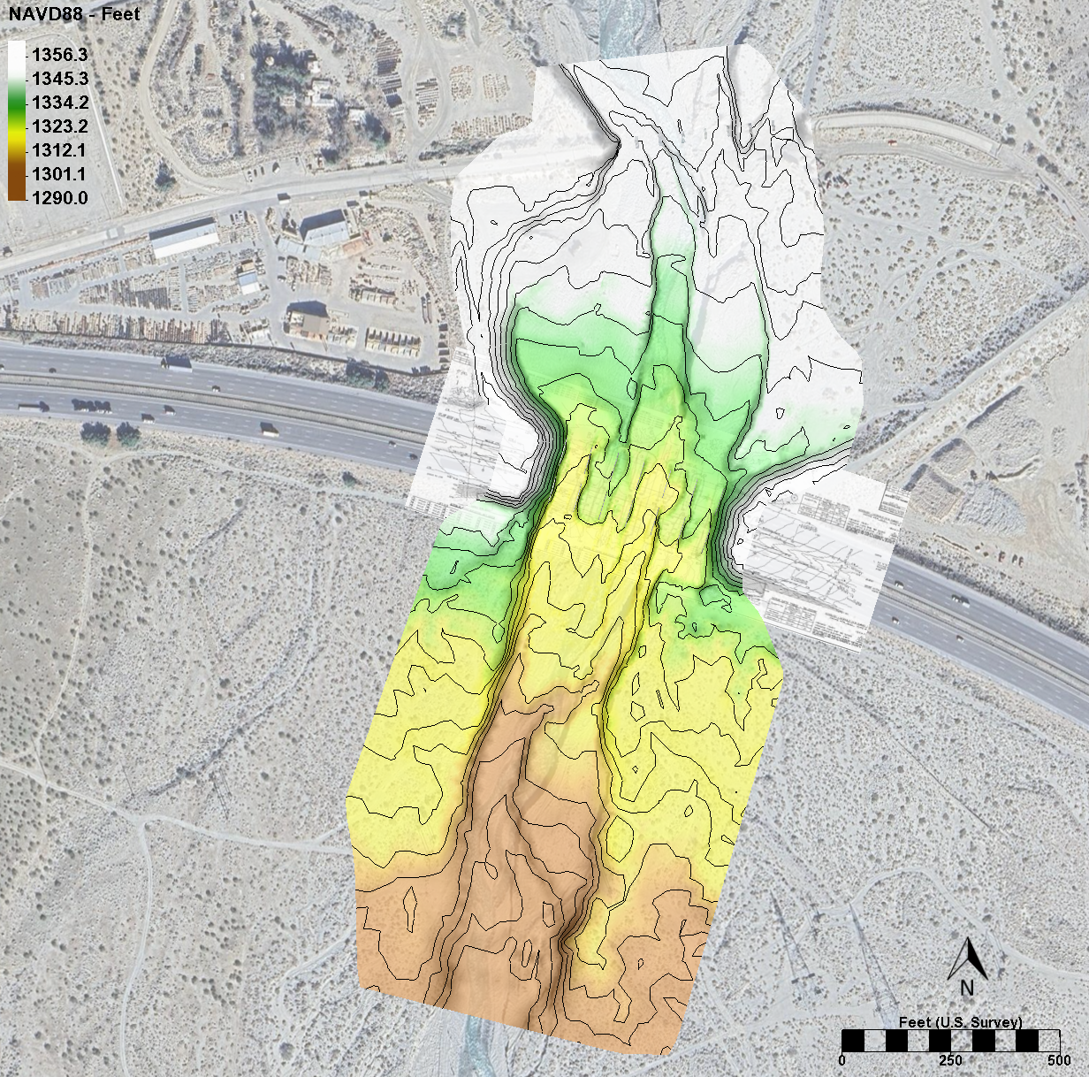
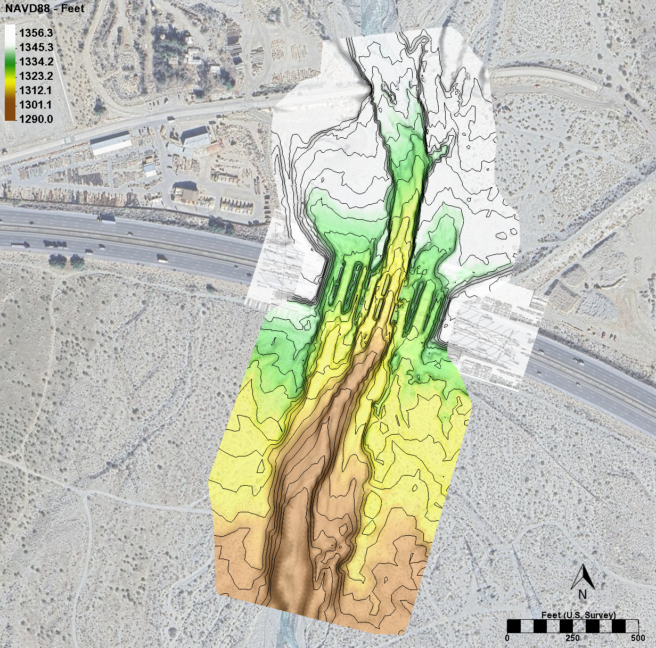
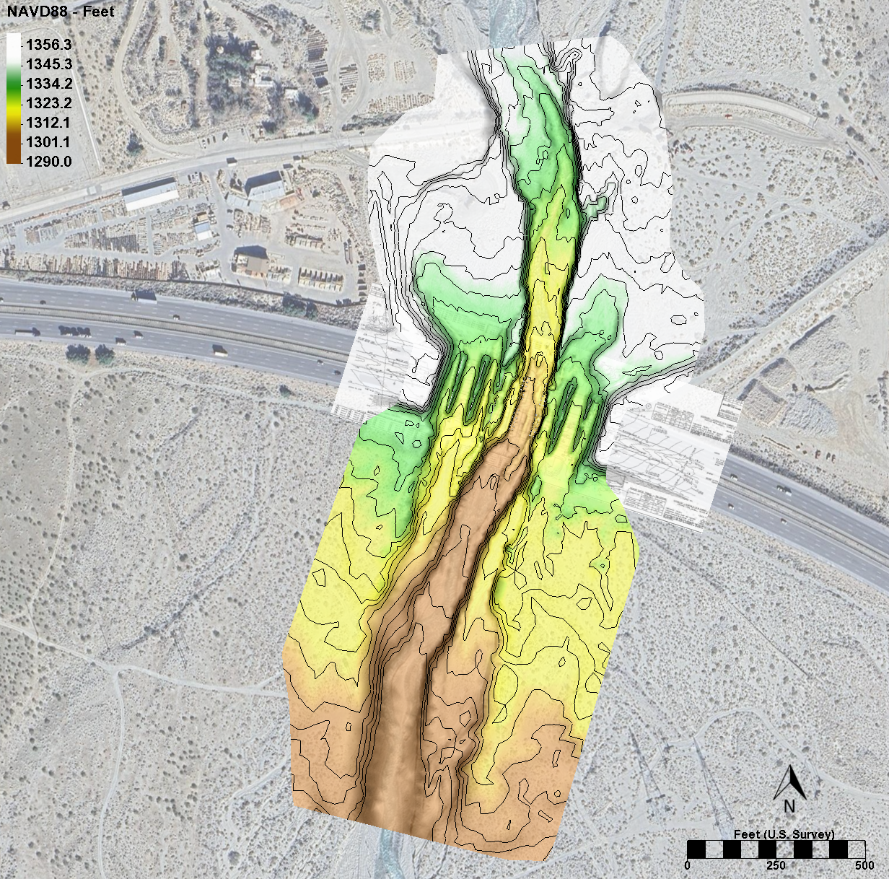
4. HYDRAULIC AND SCOUR RE-EVALUATION
Elevation Contour Map 2019 (Before Hilary)
Elevation Contour Map October 2023
Elevation Contour Map February 2024 (Current Conditions)

Slide 18
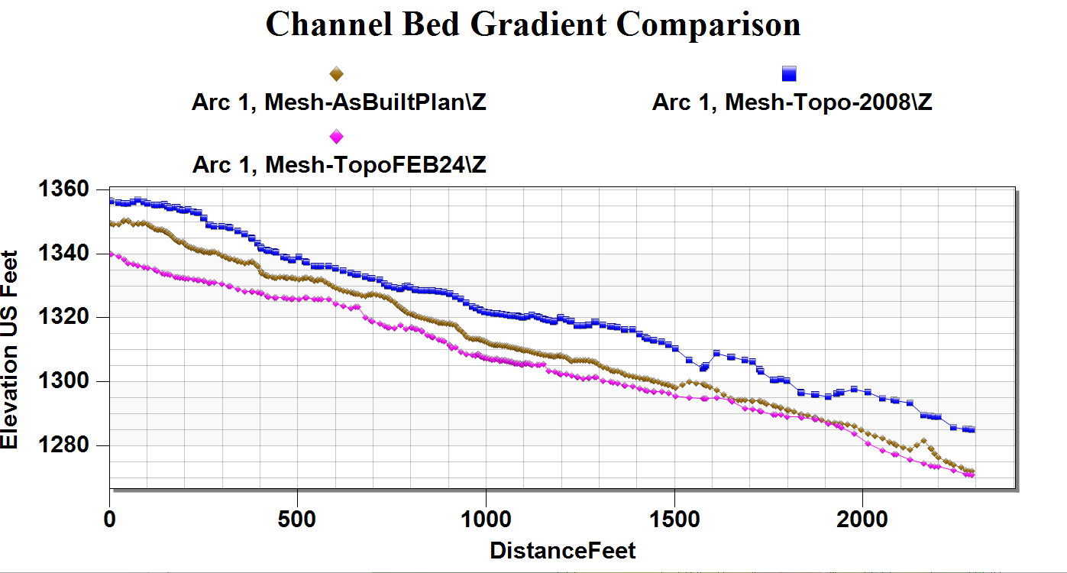
4. HYDRAULIC AND SCOUR RE-EVALUATION CONT’D
October 2023
2019
February 2024
Bridge Location

Slide 19
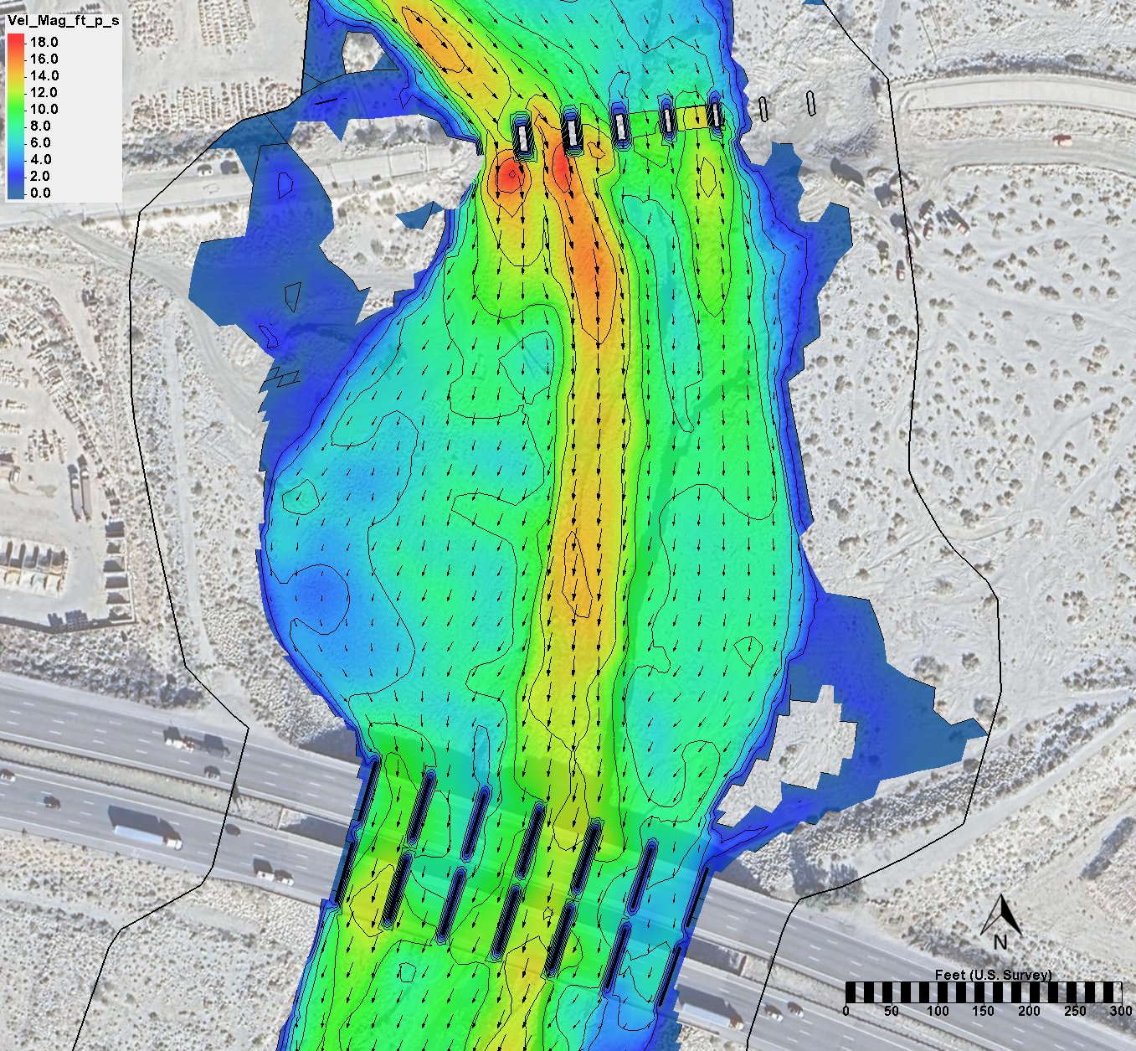
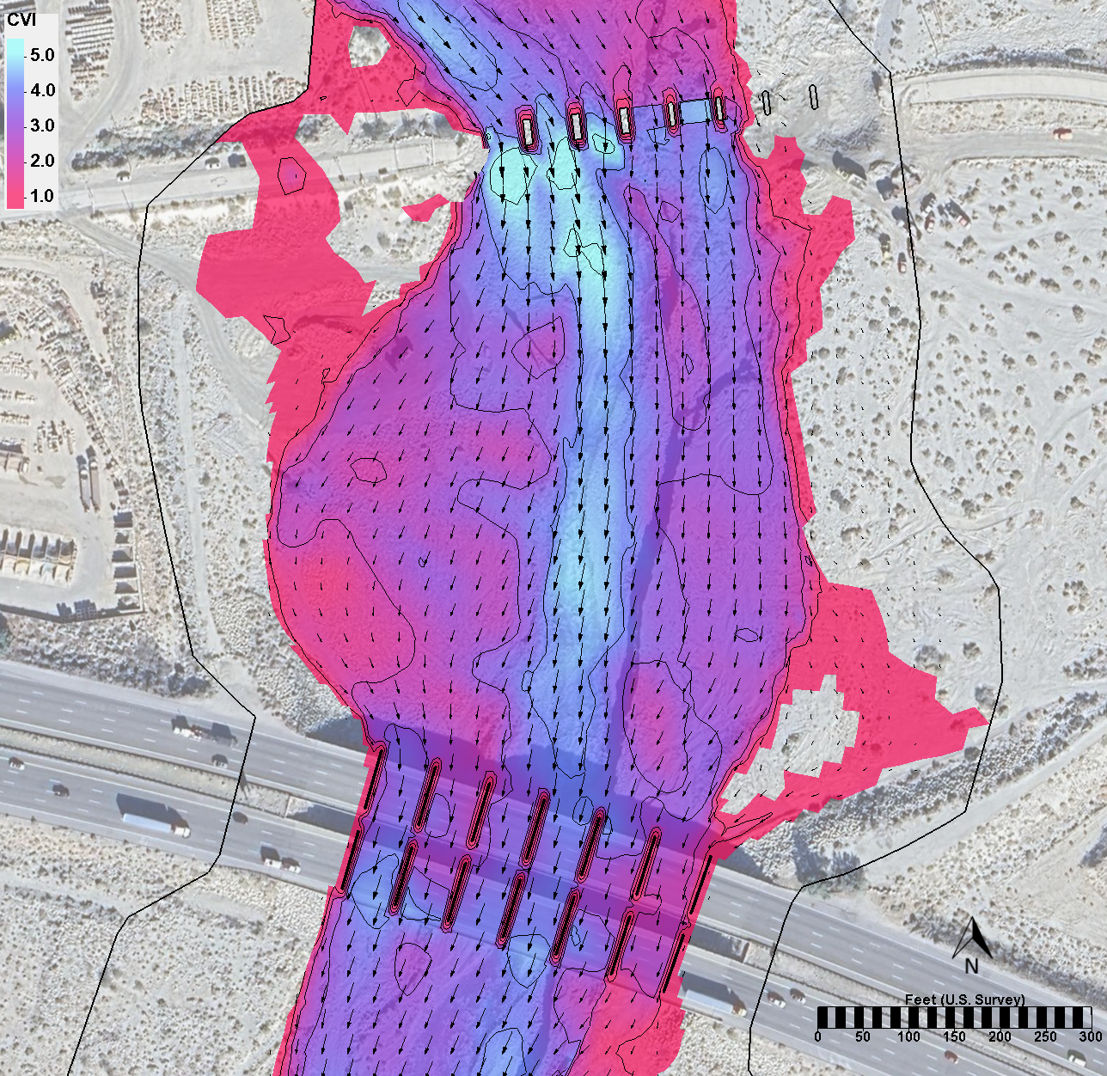
4. HYDRAULIC AND SCOUR RE-EVALUATION CONT’D
P5
P5
P6
P6
P5
P5
P6
P6
SRH-2D Simulation of Flood Conditions for Hurricane Hilary based on
2019 Bed Topography:
Estimated Peak Flow during Hilary: 24,000 CFS (50-yr Event)
Peak Velocities at the I-10 White Water River Bridge 12 – 14 [ft/s].
CRITICAL VELOCITY INDEX: CVI = Modeled Velocity / Critical Velocity

Slide 20
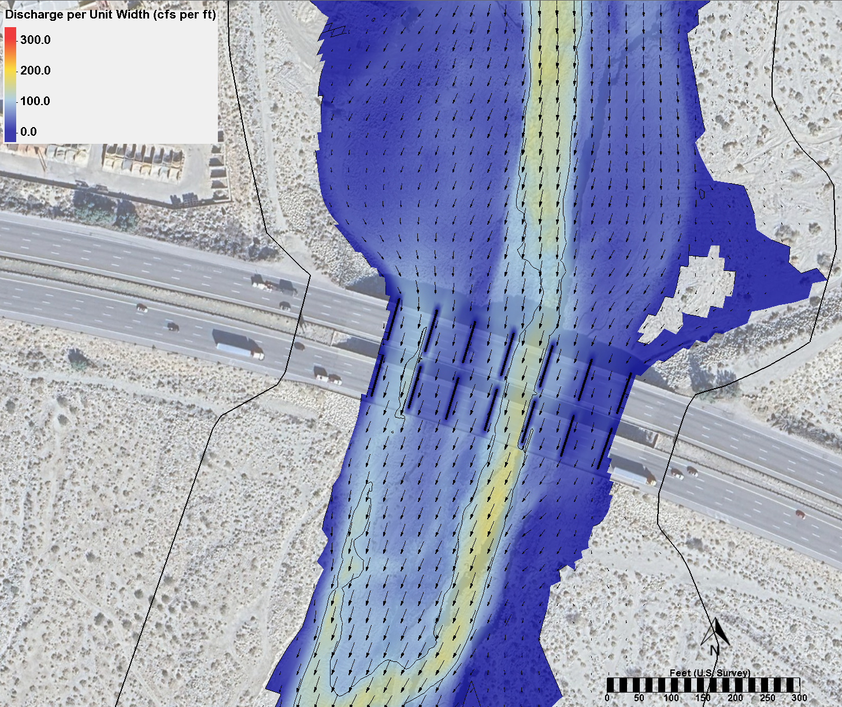
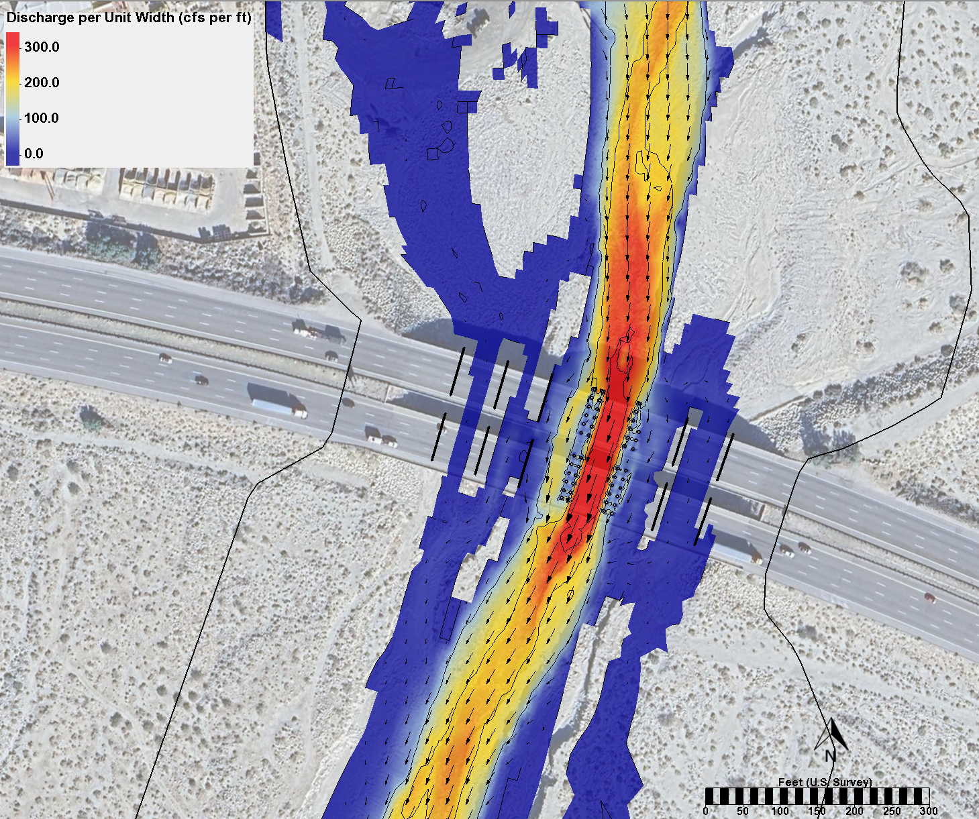
5. HYDRAULIC AND SCOUR RE-EVALUATION CONT’D
P5
P5
P6
P6
P5
P5
P6
P6
Discharge per Unit Width Results
for 50-year Flow (Hilary) – 2019 Topography
Discharge per Unit Width Results
for 50-year Flow (Hilary) – Current Conditions (2024 Topo)

Slide 21
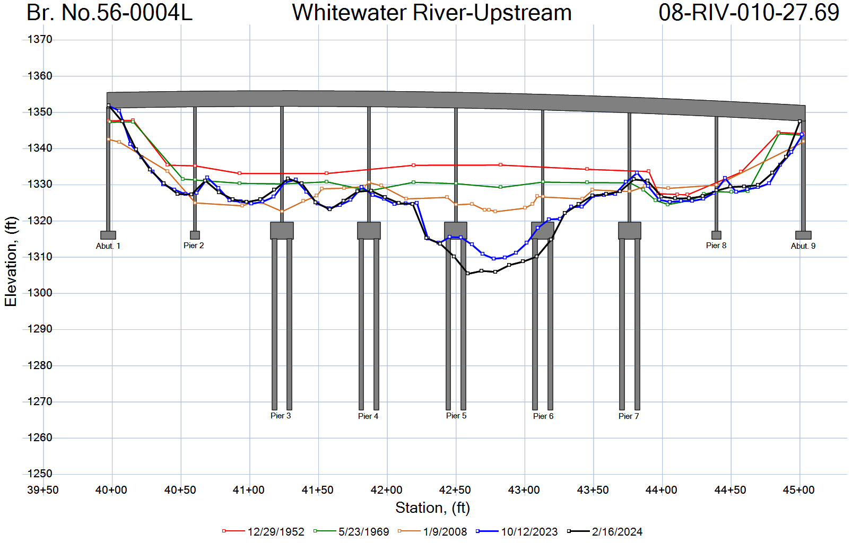
5. CURRENT CONDITIONS AND NEXT STEPS
The bridge structure is stable based on current conditions of pile exposure at Piers 5 and 6 (Office of Load Ratings)
Note: The elevations presented in this plot are referenced to the as-built plans of the original structure built 1952.

Slide 22
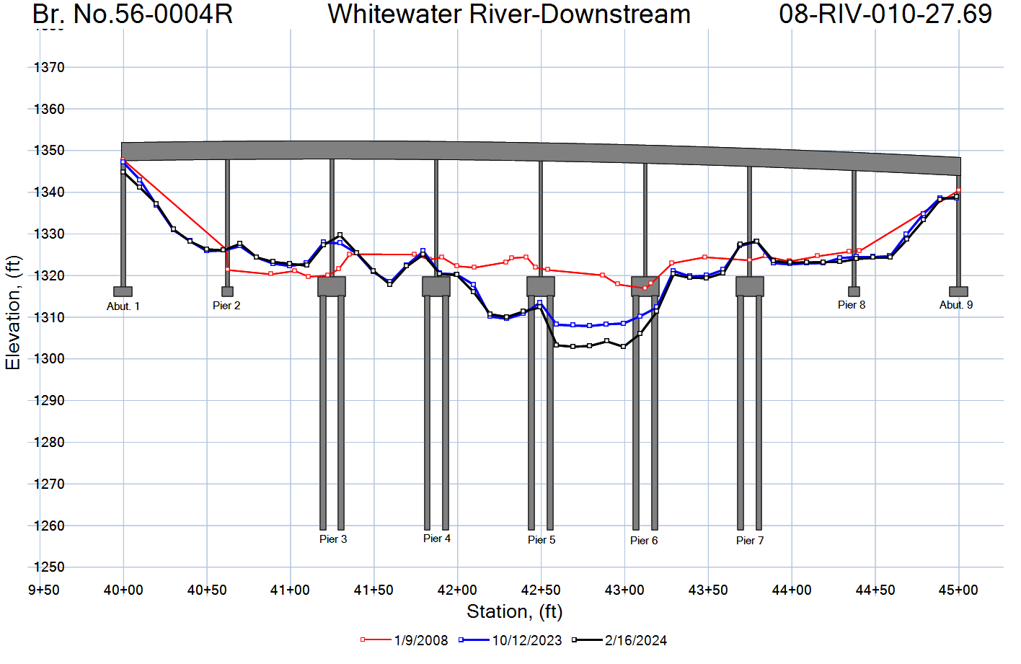
5. CURRENT CONDITIONS AND NEXT STEPS CONT’D
The bridge structure is stable based on current conditions of pile exposure at Piers 5 and 6 (Office of Load Ratings)
Note: The elevations presented in this plot are referenced to the as-built plans of the original structure built 1952.

Slide 23
5. CURRENT CONDITIONS AND NEXT STEPS CONT’D
Tilt Sensors and Water Level Meter have been installed at both bridges (Completed)
Hydraulic and Scour Re-Evaluation for 25yr, 50-yr, 100-yr and 200-yr (Completed)
Structural Stability Analysis based on predicted scour and bed degradation
performed by Load Ratings Office and Office of Geotechnical Services (Ongoing)
Structure Maintenance Investigation’s Strategy Meeting to discuss mitigation strategies for protecting both structures (Scheduled on 09/05/2024)
Thanks!

